Slide 1
Clinical Case in Neurology Infographics
Here is where this template begins

Slide 2
About Clinical Case in Neurology Infographics
This template contains an assortment of complementary infographic resources for the Clinical Case in Neurology presentation.
These infographics are adapted to the style of the aforementioned presentation, so you can insert them easily and have them completely integrated at once. You just need to do the following:
Select the element that you want to copy
Right-click and choose “Copy”
Go to the slide where you want the element to appear
Right-click and choose “Paste”

Slide 3
Clinical Case in Neurology Infographics
Mars
01
02
Mercury
Despite being red, Mars is a very cold place
Mercury is the closest planet to the Sun
Venus
03
04
Jupiter
Venus has a beautiful name, but is hot
Jupiter is the biggest planet of them all

Slide 4
Clinical Case in Neurology Infographics
01
Mars
Mercury
02
Despite being red Mars is a very cold place
Mercury is the closest planet to the Sun
03
Venus
Jupiter
04
Venus has a beautiful name, but is hot
Jupiter is the biggest planet of them all
05
Earth
Saturn
07
The Earth is the planet we all live on
Saturn is the ringed one. It’s a gas giant

Slide 5
Clinical Case in Neurology Infographics
50%
75%
60%
Earth
Jupiter
Saturn
The Earth is the planet we all live on
It is the biggest planet of them all
Saturn is the ringed one. It’s a gas giant

Slide 6
Clinical Case in Neurology Infographics
01
02
Mars
Mercury
Despite being red, Mars is a very cold place
Mercury is the closest planet to the Sun
03
04
Venus
Jupiter
Venus has a beautiful name, but is hot
Jupiter is the biggest planet of them all
05
06
Earth
Saturn
The Earth is the planet we all live on
Saturn is the ringed one. It’s a gas giant

Slide 7
Clinical Case in Neurology Infographics
Mars
25%
Despite being red Mars is a very cold place
Venus
40%
Venus has a beautiful name, but is hot
Earth
35%
The Earth is the planet we all live on

Slide 8
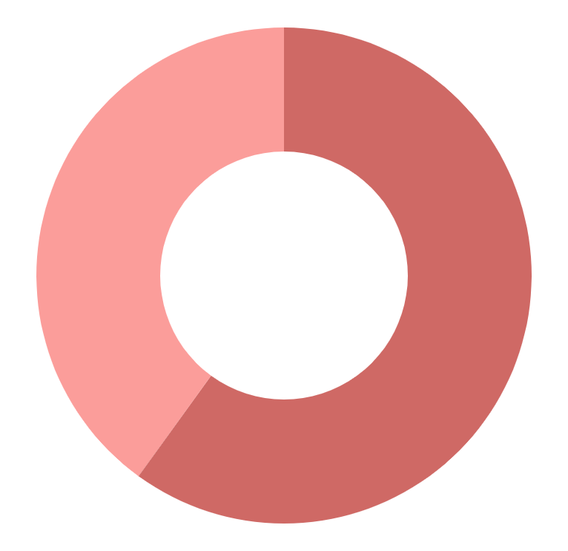
Clinical Case in Neurology Infographics
40%
60%
Mars
Mercury
Despite being red Mars is a very cold place
Mercury is the closest planet to the Sun
To modify this graph, click on it, follow the link, change the data and paste the new graph here

Slide 9
Clinical Case in Neurology Infographics
01
02
03
Venus
Earth
Jupiter
Venus has a beautiful name, but is hot
The Earth is the planet we all live on
Jupiter is the biggest planet of them all

Slide 10
Clinical Case in Neurology Infographics
01
Mars
25%
Despite being red, Mars is a very cold place
Mercury
Mercury is the closest planet to the Sun
02
Venus
Venus has a beautiful name, but is hot
75%
Jupiter
03
Jupiter is the biggest planet of them all
Earth
The Earth is the planet we all live on

Slide 11
Clinical Case in Neurology Infographics
01
02
03
Venus
Mars
Mercury
It has a beautiful name, but is hot
Despite being red, Mars is very cold
It is the closest planet to the Sun
04
05
Earth
Jupiter
The Earth is the planet we all live on
Jupiter is the biggest planet of them all

Slide 12
Clinical Case in Neurology Infographics
Diagnosis | Intervention | Medicine
Mercury | It is the closest planet to the Sun and the smallest one | Mercury was named after the Roman messenger god
Mars | Despite being red, Mars is actually a cold place | The Iron oxide dust gives the planet its reddish cast
Venus | Venus has a beautiful name and is the second planet | It’s the second-brightest natural object in the night sky
Saturn | Saturn is a gas giant and has several rings | It's composed mostly of hydrogen and helium
Jupiter | It is a gas giant and the biggest planet in the System | It's the fourth-brightest object in the night sky

Slide 13
Clinical Case in Neurology Infographics
01
03
Mars
Earth
Despite being red, Mars is a very cold place
The Earth is the planet we all live on
02
Venus
Venus has a beautiful name, but is hot

Slide 14
Clinical Case in Neurology Infographics
Contraindications
Indications
Contraindication 1
Contraindication 2
Contraindication 3
Contraindication 4
Contraindication 5
Contraindication 6
Contraindication 7
Indication 1
Indication 2
Indication 3
Indication 4
Indication 5
Indication 6
Indication 7
Notes
This planet's name has nothing to do with the liquid metal, since Mercury was named after the Roman messenger god

Slide 15
Clinical Case in Neurology Infographics
+30%
-50%
+40%
-40%
+20%
-10%
Earth
Jupiter
Saturn
Venus
Mars
Pluto
Earth is where we all live on
It is the biggest planet
Saturn is the ringed one
It has a very nice name
It is a red and cold place
Pluto is a dwarf planet

Slide 16
Clinical Case in Neurology Infographics
Age | 35 years old
Gender | Female
Location | Málaga
Conditions | Hypertension
2020
2022
2024
Venus
Earth
Jupiter
Venus has a beautiful name, but is hot
The Earth is the planet we all live on
Jupiter is the biggest planet of them all

Slide 17
Clinical Case in Neurology Infographics
Mon | Tue | Wed | Thu | Fri | Sat | Sun
8:00 | 9:00 | 10:00 | 11:00 | 12:00 | 13:00 | 14:00
Test 1 | Test 2 | Test 3 | Test 4 | Test 5 | Test 6 | Test 7
Mon | Tue | Wed | Thu | Fri | Sat | Sun
15:00 | 16:00 | 17:00 | 18:00 | 19:00 | 20:00 | 21:00
Test 8 | Test 9 | Test 10 | Test 11 | Test 12 | Test 13 | Test 14

Slide 18
Clinical Case in Neurology Infographics
25%
35%
Saturn
Mars
Saturn is composed mostly of hydrogen and also helium
Despite being red, Mars is actually a very cold place
25%
15%
Earth
Jupiter
The Earth is the only one that harbors life in the System
Jupiter is a gas giant and the biggest planet of them all

Slide 19
Clinical Case in Neurology Infographics
Saturn
Mercury
Saturn is a gas giant and has several rings. Saturn is composed mostly of hydrogen and helium
This planet's name has nothing to do with the liquid metal, since Mercury was named after the Roman god
Option A
Option A
25%
50%
Option B
Option B
75%
50%

Slide 20
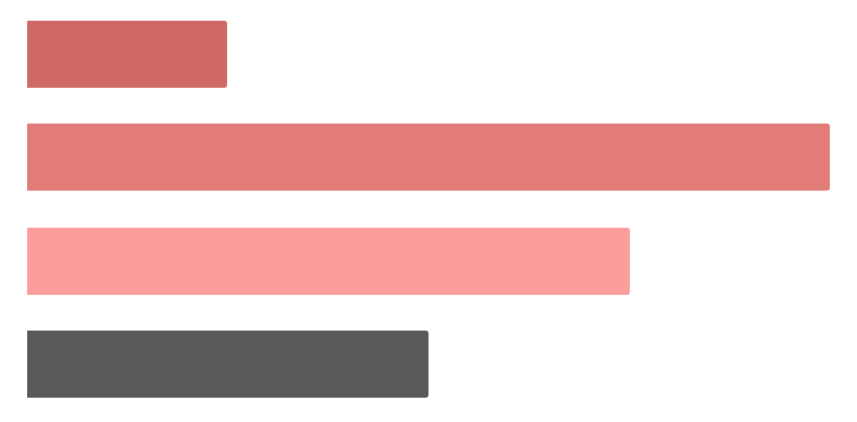
Clinical Case in Neurology Infographics
20%
Mars
Mars is the red planet
100%
Mercury
It is the smallest one
75%
Jupiter
It is the biggest one
50%
Saturn
It is the ringed planet
To modify this graph, click on it, follow the link, change the data and paste the new graph here

Slide 21
Clinical Case in Neurology Infographics
Dr. John Doe
Dr. Tina James
Despite being red, Mars is a very cold place
Mercury is the closest planet to the Sun
Dr. Helena Doe
Dr. Tim Jones
Venus has a beautiful name, but is hot
Jupiter is the biggest planet of them all

Slide 22
Clinical Case in Neurology Infographics
01
02
03
2000
2010
2020
Earth
Jupiter
Saturn
The Earth is the planet we all live on
It is the biggest planet of them all
Saturn is the ringed one. It’s a gas giant

Slide 23
Clinical Case in Neurology Infographics
Mercury
Jupiter
It is the closest planet to the Sun and is very small
It’s a gas giant and the biggest planet in our Solar System
Mars
Venus
Mars is actually a cold place full of iron oxide dust
Venus is the second planet from the Sun and it’s terribly hot

Slide 24
Clinical Case in Neurology Infographics
Week 1
Week 2
Week 3
Saturn is a gas giant and has several rings
It is a big gas giant named after the Roman god
Despite being red, Mars is a very cold planet
Venus
Mercury
Mars
50%
100%
25%
Jupiter
Earth
Neptune
60%
0%
75%

Slide 25
Clinical Case in Neurology Infographics
Jupiter
Venus
Age | Gender | Location
40 years old | Male | Barcelona
It is the biggest planet of them all
It has a beautiful name but is hot
Allergies | Vaccines | Surgery
Fish | Covid-19 | None
2020
80%
2020
20%

Slide 26
Clinical Case in Neurology Infographics
Phase 1
Phase 2
Phase 3
Phase 4
Saturn
Mars
Earth
Jupiter
Saturn is the ringed one. It’s a gas giant
Despite being red, Mars is a cold place
The Earth is the planet we all live on
It is the biggest planet of them all
20%
30%
40%
10%

Slide 27
Clinical Case in Neurology Infographics
01
05
02
04
Venus
03
Mercury
It has a beautiful name but is hot
It is the closest planet to the Sun
Earth
Jupiter
The Earth is the planet we all live on
Jupiter is the biggest planet of them all
Mars
Despite being red, Mars is very cold

Slide 28
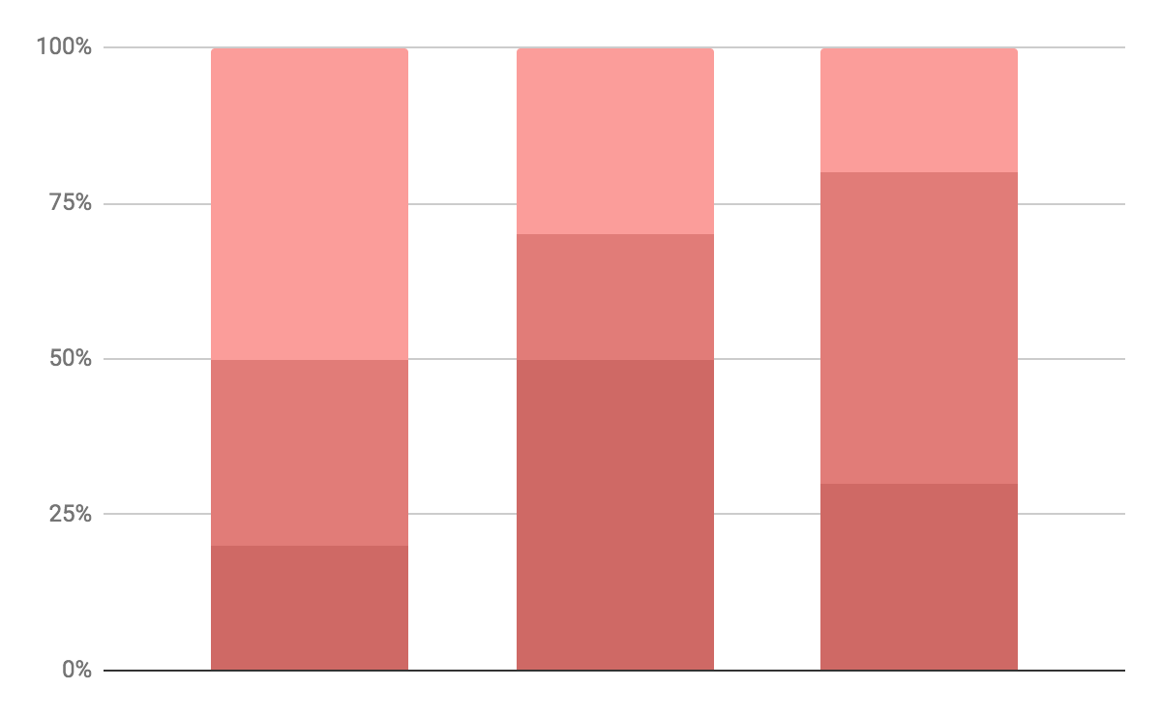
Clinical Case in Neurology Infographics
Mercury
A
Mercury is the closest planet to the Sun
Jupiter
B
Jupiter is the biggest planet of them all
Saturn
C
Saturn is the ringed one. It’s a gas giant
To modify this graph, click on it, follow the link, change the data and paste the new graph here

Slide 29
Clinical Case in Neurology Infographics
Pros
Cons
Earth
Jupiter
Saturn
Venus
Mars
Pluto
Earth is where we all live on
It is the biggest planet
Saturn is the ringed one
It has a very nice name
It is a red and cold place
Pluto is a dwarf planet

Slide 30
Clinical Case in Neurology Infographics
Case 1
Case 2
Mercury
Mercury is the closest planet to the Sun
Jupiter
Jupiter is the biggest planet of them all
Saturn
Saturn is the ringed one. It’s a gas giant

Slide 31
Clinical Case in Neurology Infographics
Mercury
This planet's name has nothing to do with the liquid metal, since Mercury was named after a god
60%
Saturn
Saturn is a gas giant and has several rings. Saturn is composed mostly of hydrogen and helium
40%

Slide 32
Clinical Case in Neurology Infographics
Jupiter
Mercury
75%
It is the biggest planet of them all
25%
It is the smallest planet of them all
Mars
Venus
50%
Despite being red, Mars is cold
50%
Venus has very beautiful name

Slide 33
Instructions for use (premium users)
In order to use this template, you must be a Premium user on Slidesgo.
You are allowed to:
Modify this template.
Use it for both personal and commercial purposes.
Hide or delete the “Thanks” slide and the mention to Slidesgo in the credits.
Share this template in an editable format with people who are not part of your team.
You are not allowed to:
Sublicense, sell or rent this Slidesgo Template (or a modified version of this Slidesgo Template).
Distribute this Slidesgo Template (or a modified version of this Slidesgo Template) or include it in a database or in any other product or service that offers downloadable images, icons or presentations that may be subject to distribution or resale.
Use any of the elements that are part of this Slidesgo Template in an isolated and separated way from this Template.
Register any of the elements that are part of this template as a trademark or logo, or register it as a work in an intellectual property registry or similar.
For more information about editing slides, please read our FAQs or visit Slidesgo School:
https://slidesgo.com/faqs and https://slidesgo.com/slidesgo-school

Slide 34
Premium infographics...
Text 1
Text 2
Text 3
Add the Title here
2016
2017
2018
2019
2020
Text 4
Text 5
Text 6
“Mercury is closest planet to the Sun and the smallest”
“Despite being red, Mars is a cold place full of iron oxide”
“Venus has a beautiful name and is the second planet”
“Neptune is the farthest-known planet from the Sun”
“Saturn is a gas giant and has several rings”

Slide 35
Premium infographics...
75%
“Mercury is closest planet to the Sun and the smallest”
75%
“Mercury is closest planet to the Sun and the smallest”
TITLE 1
“Mercury is closest planet to the Sun and the smallest”
“Mercury is closest planet to the Sun and the smallest”

Slide 36
Premium Icons

Slide 37
Premium Icons

Slide 38
Premium Icons

Slide 39
Premium Icons

Slide 40
Premium Icons

Slide 41
Infographics
You can add and edit some infographics to your presentation to present your data in a visual way.
Choose your favourite infographic and insert it in your presentation using Ctrl C + Ctrl V or Cmd C + Cmd V in Mac.
Select one of the parts and ungroup it by right-clicking and choosing “Ungroup”.
Change the color by clicking on the paint bucket.
Then resize the element by clicking and dragging one of the square-shaped points of its bounding box (the cursor should look like a double-headed arrow). Remember to hold Shift while dragging to keep the proportions.
Group the elements again by selecting them, right-clicking and choosing “Group”.
Repeat the steps above with the other parts and when you’re done editing, copy the end result and paste it into your presentation.
Remember to choose the “Keep source formatting” option so that it keeps the design. For more info, please visit Slidesgo School.

